Slide 1

Global Measles and Rubella Cases
Programming for Data Science Assessment
Notes:
Introduce myself and the topic

Slide 2

Dataset
Dataset downloaded from tidytuesday
Originally from the World Health Organisation (WHO) provisional data on measles and rubella
Two main datasets used
Dataset 1
Included data by country, WHO regions and year (2012-2025)
Dataset 2
Included data by country, WHO regions, year (2012-2025) and month
Supplementary dataset
Measles vaccination coverage (%) in each WHO region between 2012-2024
Obtained from WHO website:
https://immunizationdata.who.int/global/wiise-detail-page/measles-vaccination-coverage?GROUP=WHO_REGIONS&ANTIGEN=MCV2&YEAR=&CODE=
https://en.wikipedia.org/wiki/File:Who_logo.svg
Notes:
Mention why I chose the dataset and where it originates from.
Explain the main datasets in more detail- mention some of the variables/columns and it structure
Explain why I decided to use a separate supplementary dataset .

Slide 3
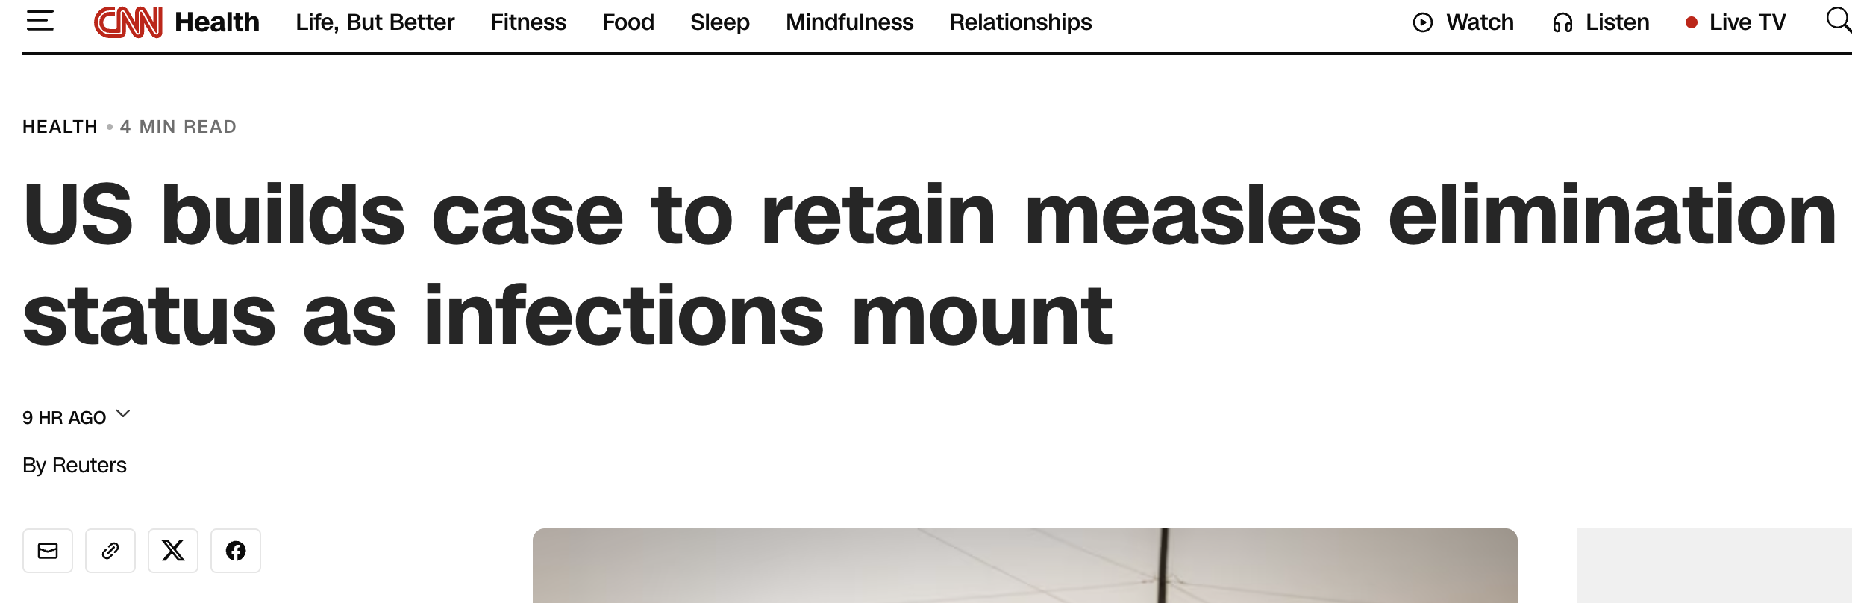
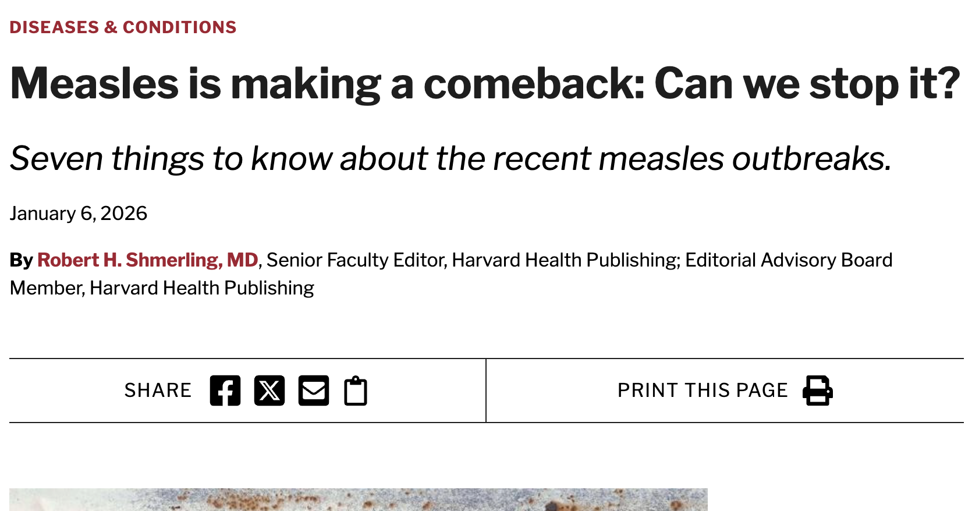
What is measles and rubella?
Both are highly contagious viruses
Airborne (coughs and sneezes)
Rubella
Rare and mild disease
Can cause miscarriage and development of foetus
Measles
Dangerous disease - brain damage, pneumonia, blindness
Caused 95,000 deaths globally in 2024 (WHO, 2025)
1 in 15 become seriously unwell (GOV UK, 2024)
Vaccination is the only prevention
Notes:
Describe what measles and rubella is and their dangers
Describe the recent news articles (screenshots) indicating a rise in cases in the United States and why cases should be monitored

Slide 4
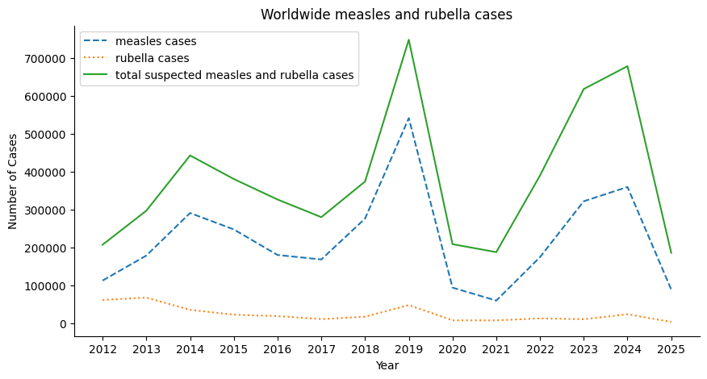
Global measles and rubella cases between 2012-2025
Rubella cases are low
Less than 100,000 cases per year
Measles cases fluctuate considerably
Sharp rise in 2019 and 2024
Reasons- pandemic, vaccine hesitancy, political factors
Notes:
Talk about the rarity of rubella cases compared to measles
Describe how measles cases fluctuate and the peaks in 2019 and 2024
Explain possible reasons for the peaks- vaccine hesitancy in some countries, disruption in immunization programs due to covid, wars and political factors

Slide 5
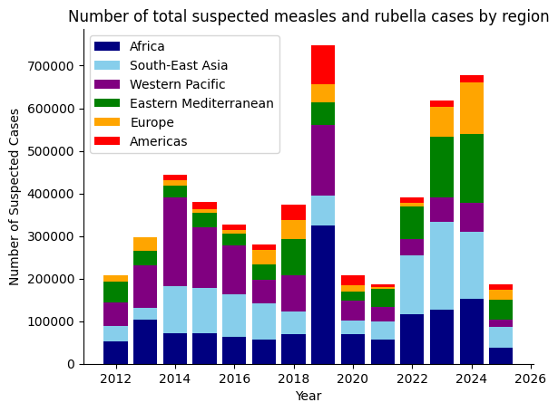
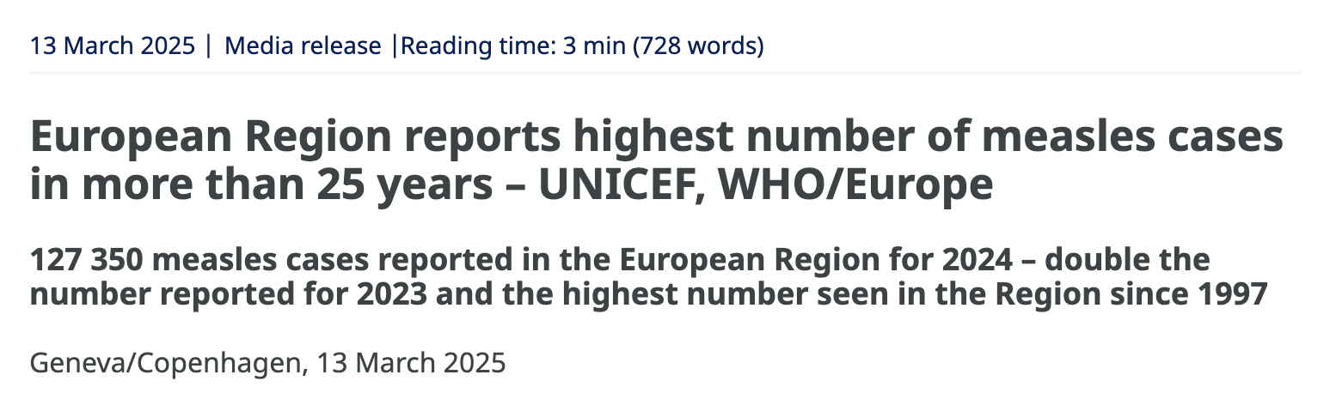
Suspected measles and rubella cases by region
Africa, South-East Asia and Western Pacific major contributors
2019 peak
Dominated by Africa
Cases in Americas peaked
2023 and 2024 peak
Sharp rise in Europe and Easter Mediterranean
Notes:
Describe how this graph is similar to the previous graph but helps understand the distribution of cases each year based on regions
Describe how we can use the graph to identify why/ which region caused the spikes in 2019 and 2024
Describe how the graph (2023 and 2024 peak) findings corroborate with the screenshot

Slide 6
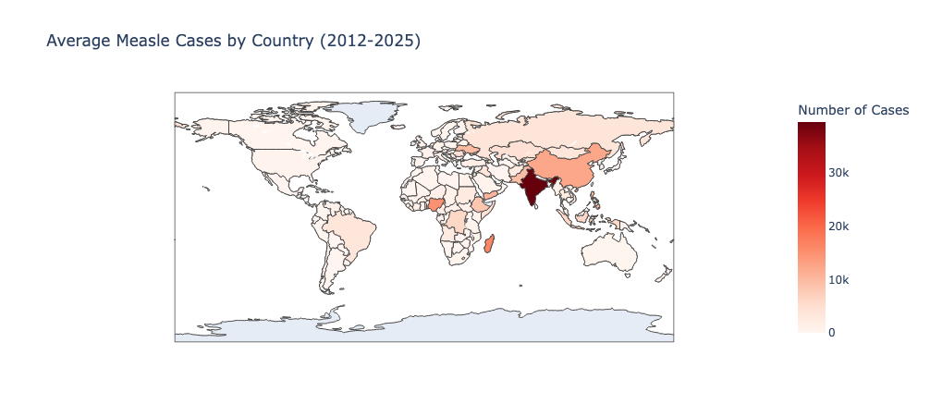
Average measles cases by country (2012-2025)
Highest number of cases in India and China
Due to population size
South-East Asian and African countries have highest number of cases on average
Notes:
Describe how the plot helps identify the countries or regions where the number of measles cases recorded are high
Describe how the plot helps to easily visualize measles cases in all countries in the dataset. Otherwise, it's difficult to include all countries in a single plot such as a bar plot

Slide 7
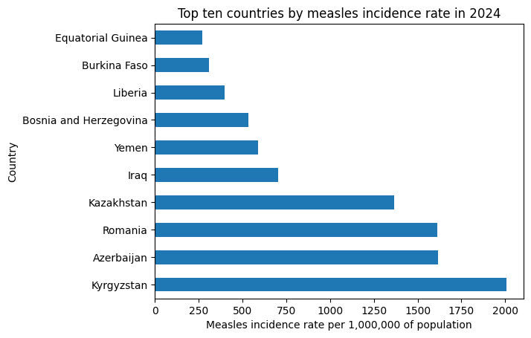
Countries with the highest measles incidence rates in 2024
High incidence rates in Middle Eastern and Eastern European countries
Notes:
Describe what measles incidence rate is and how its calculated
Explain that the graph could indicate large measles outbreaks in Kyrgyzstan, Azerbaijan, Romania and Kazakhstan in 2024

Slide 8
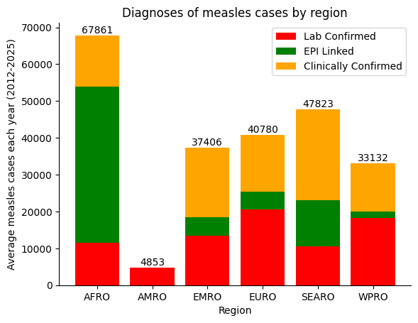
Identifying the main diagnosis method for measles in each region
Africa
Cases mainly diagnosed by EPI linkage
Americas, Europe and Western Pacific
Predominantly Lab confirmed cases
South East Asia and Eastern Mediterranean
Predominantly Clinically confirmed cases
Notes:
Describe how the main method used for measles diagnosis varies in each region
Describe how the main diagnosis method used could indicate laboratory capacity and health care infrastructure of the region

Slide 9
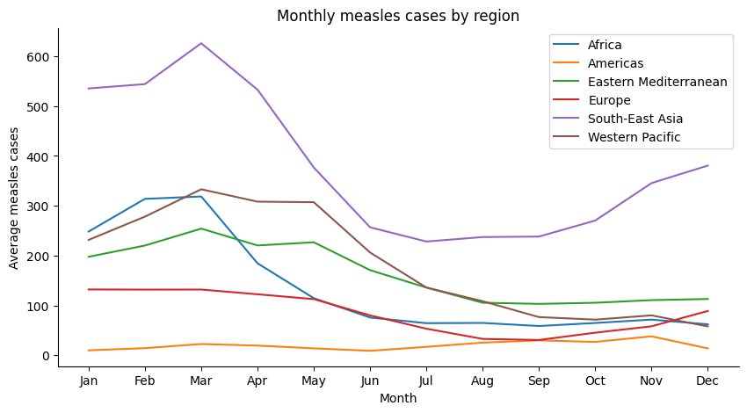
Seasonal variation in measles cases
Cases appear to peak around March in most regions
Cases are lowest around July-August
Cases in South-East Asia and Europe start rising between October-November
Notes:
Describe how this graph helps identify seasonal variation in measles cases by region
Cases in general peak around March, are lowest between July-August and likely start to rise again from November

Slide 10
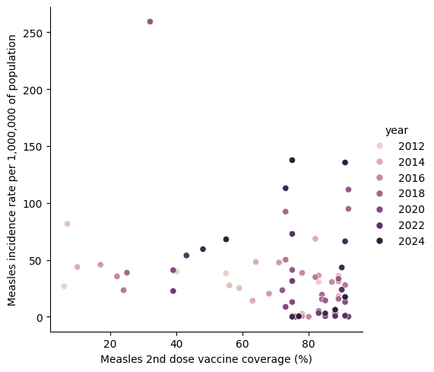
Relationship between measles incidence rate and vaccination coverage
Darker spots cluster around 80%
Indicates vaccine coverage has generally increased over time
Higher the vaccine coverage, the lower incidence rate in general
Not very clear but still visible
Lots of outliers
Notes:
Describe how the graph helps depict vaccine coverage over time as well as the relationship between vaccine coverage and measles incidence rate

Slide 11
Challenges with the code
Understanding and correctly using the group or pivot table function based on the need for the graph
Identifying which format (long or short) to store the dataframe
Example:
The above code with grouping would calculate mean for each region by dividing over the sum of all countries in the region and its corresponding year
If I wanted the mean measles cases in each region by year only (cases/year) , the above code would not be effective
Notes:
Describe how grouping the data effectively was a challenge when creating particular figures
Describe how different plots required the data to be formatted differently (either long or short formatting)
Explain the example in detail

Slide 12
References
WHO (2025). Measles Factsheet. Retrieved from https://www.who.int/news-room/fact-sheets/detail/measles
UK GOV (2024). Measles Factsheet. Retrieved from https://www.gov.uk/government/publications/national-measles-guidelines/measles-factsheet

Slide 13
Thank you for listening

